Slide 1
International Vaccine Codes (IVC) Initiative
13 MaY 2026
IVC Name & Scope – MMR/MMRV

Slide 2
Welcome and Introductions
Name | Organization
Nathan Bunker | AIRA
Damon Ferlazzo | AIRA
Barbara Wootner | Colorado IIS
Myriam Talantikit | Canada HealthInfoWay
David Crowell | Nevada IIS
Paloma Hawry | CDC
Sandra Ayriss | KL&A
Shelby Sandstrom | AIRA
François Kaag | Syadem
Gita Prabhakar | HLN
Clément Henniquin | NIST
Cecilia Sandoval | California IIS
Brittany Onye | Washington IIS
Eduardo Ballestero | Kentucky IIS
Theresa Case | Athena Health
Name | Organization
Faisal Reza | CDC
Amedagli | Canada
Elias Blumenthal
Laurel Okorofsky
Danielle Woods
Please tell us:
  Your name,
  Your organization

Slide 3

Agenda
Updates and Events
  Country Interviews
IVC Scope and Name
MMR/MMRV
  Initial Discussion

Slide 4
Upcoming Interoperability Meetings
16-22 May – HL7 Connectathon and Working Group Meeting – SS Rotterdam Netherlands
19-21 May – HIMSS 26 – Copenhagen
15-18 June – FHIR DevDays – Minneapolis Minnesota US
19-25 September – Working Group Meeting and HL7 FHIR Connectathon –
Rockville Maryland US
22-24 October – SNOMED Conference – Sydney Australia

Slide 5
SNOMED Extension Release
Another version coming in the next few weeks
Can IVC can provide an update to the group when that happens and how to access it? Yes
Can be viewed:
  From SNOMED browsers
  And from the IVC website, there is a NUVA/SNOMED folder

Slide 6
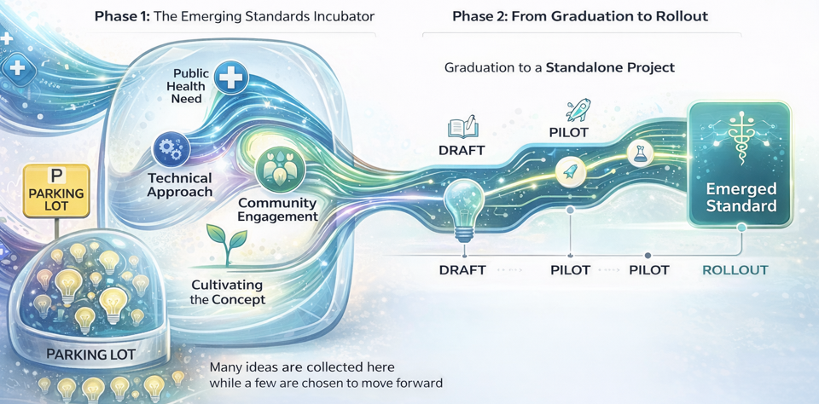
Immunization Focus Group (IFG)
International standards for immunizations
  Fast Healthcare Interoperability Resources (FHIR)
Organized under the Public Health Work Group
  Meeting every two weeks
  Next meeting: Friday, May 22 at 11am US ET / 4pm Paris/Berlin time
Current topics
  Immunization Decision Support + Health, Age, Lifestyle, Occupation (ImmDS + HALO)
  Schedule Authority in HL7 v2 and FHIR
  Introduction to Additional Topics

Slide 7
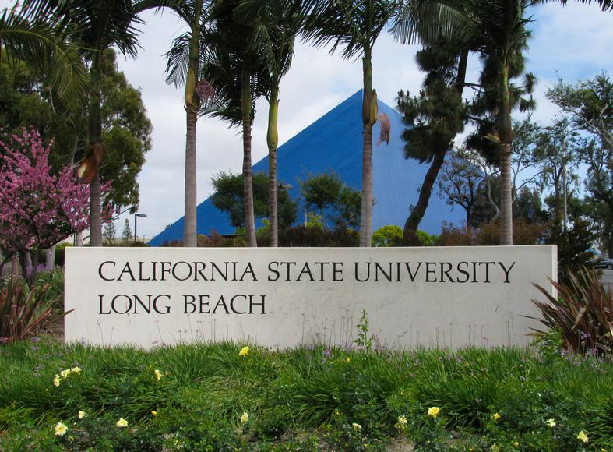
Country Interviews
Trying to start project for this past year
We are interviewing students for a summer program
We have some good candidates and expect to start soon

Slide 8
Any Other Updates?

Slide 9
IVC Scope and Name
Group Discussion

Slide 10
IVC Scope
Supporting the recording of a complete immunization history for any patient who received a vaccination at any time and in any country
  Need to figure out in standards how to handle cases when code can’t be mapped, need to find optimal ways to handle this.
Recording needs to be accurate enough to determine what the disease the patient is protected against and what additional vaccination they made need and when
Coding to ensure individual and community protection from diseases
  Differentiate from other pharmaceuticals: Immunizations are relevant for decades

Slide 11
IVC Scope
In Scope
  Vaccine code set management
  National and universal code sets
  Technical and detailed level codes
  Lifetime vaccination records
  Emergency and clinical trial vaccinations
Out of Scope
  Policy discussions
  Code set selection
  Software and systems
Close but not in scope
  Medication supply
  Inventory
  Pharmacovigilance

Slide 12
Vocabulary and Standards
Clean architectural fantasy
  Terminology experts define concepts and codes
  Messaging experts define structures and transport
  Systems simply combine both
But in practice boundaries leak constantly
  Dose number: “DTaP Dose 2”
  Vaccine, product, or medication
  Abstract or branded vaccine concepts

Slide 13
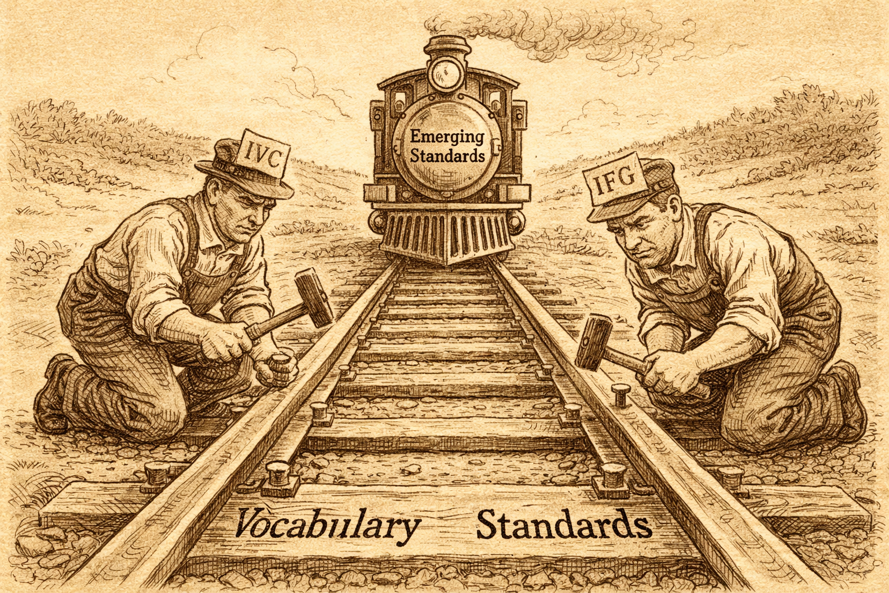

Slide 14
IVC Scope + Proposed Change
In Scope
  Vaccine code set management
  National and universal code sets
  Technical and detailed level codes
  Lifetime vaccination records
  Emergency and clinical trial vaccinations
  Peri-Vaccination Vocabulary
    Support evaluation and recommendation workflows: including contextual conditions, recommendation statuses, and schedule authority identifiers
Out of Scope
  Policy discussions
  Code set selection
  Software and systems
Close but not in scope
  Medication supply
  Inventory
  Pharmacovigilance
  Broader cross-domain problems not unique to immunization interoperability

Slide 15
Improving the ImmDS Model
Adding concept of Contextual Conditions
Basic workflow stays the same
Not specifying
  Internal CDS logic
  UI or workflow of health system
Health System
Date of Birth
CDS Engine
Immunizations
Contextual Conditions
Recommendations

Slide 16
Maternal RSV Vaccination Status
If mother gets RSV vaccine while pregnant
  Baby does not need RSV antibody (nirsevimab or clesrovimab)
Problem
  RSV vaccine documented on mother’s record not baby
Example
Notes:
1. Open with their problem (2–3 minutes)
Purpose: Signal you heard them correctly.
Say, succinctly:
Nevada asked how to report maternal RSV vaccination status during pregnancy when sending a newborn birth-dose Hep B.
The motivation is forecast accuracy (RSV mAb recommendations), not record-keeping for the mother.
HL7 v2 today has no standard way to represent non-vaccine conditions that affect immunization recommendations.
That forced the question: do we solve RSV specifically, or the class of problems this represents?
Stop there. No details. No blame.

Slide 17
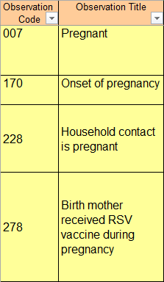
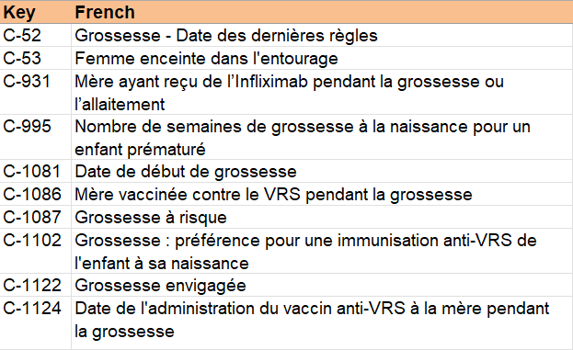
U.S. – CDSi
French – Mes Vaccins

Slide 18
Example
OBX|1|ID|278^Birth mother received RSV vaccine during pregnancy^https://ivci.org/cc/usa/cdc-cdsi|1|Y^Yes^HL70136||||||F
OBX-3.1 = Observation from CDSi
OBX-3.3 = Code table identifies CDSi project
OBX-5 = Yes
  Could also be No
  Do not send OBX if not known

Slide 19
IVC Scope + Proposed Change
In Scope
  Vaccine code set management
  National and universal code sets
  Technical and detailed level codes
  Lifetime vaccination records
  Emergency and clinical trial vaccinations
  Peri-Vaccination Vocabulary
    Support evaluation and recommendation workflows: including contextual conditions, recommendation statuses, and schedule authority identifiers
Out of Scope
  Policy discussions
  Code set selection
  Software and systems
Close but not in scope
  Medication supply
  Inventory
  Pharmacovigilance
  Broader cross-domain problems not unique to immunization interoperability

Slide 20
Name Discussion
“International” is misleading
  Sounds geopolitical rather than technical
  Suggests work is primarily about cross-border exchange
  Implies group service non-US use cases
  For participation and funding “international” often reads as “outside our mission area”
Actual mission is
  Immunization interoperability vocabulary
  Practical terminology infrastructure
  Vaccine and peri-vaccination vocabularies
  Support for recommendation interoperability
  Collaboration across jurisdictions where useful
International participation is an attribute of the work, not the primary purpose

Slide 21
Proposed New Name
Immunization Vocabularies Collaborative (IVC)
Naturally includes:
Administered products
Recommendations
Contextual conditions
Evaluation statuses
Schedule authority
Implicitly communicates:
Multiple local systems
Coexistence rather than replacement
Cataloging rather than central control
Interoperability between vocabularies
Implies:
Working group
Community effort
Shared exploration
Openness

Slide 22
MMR and MMRV
Vaccine Topic

Slide 23
MMR and MMRV
How do your systems represent the relationship between MMR and MMRV?
When a jurisdiction or system transitions between MMR and MMRV, what vocabulary or coding challenges appear in historical records and forecasting systems?
Do your recommendation systems reason primarily from vaccine products, antigen content, or both?
How do your systems represent local schedule authority or jurisdiction-specific guidance when evaluating MMR/MMRV histories?
Are there contextual conditions or patient factors that significantly affect how MMR or MMRV recommendations are evaluated in your systems?
Looking at MMR and MMRV specifically, what important concepts are currently difficult to code, exchange, or interpret consistently across systems or jurisdictions?

Slide 24
Thank You!
The work you are doing is so important.
Thank you for taking time to help move this project forward.
Next Meeting
  10 June 2026
  Topic:
    MMR and MMRV
      Recommendations become more complicated, challenges with CDS
    Contextual Conditions

